Slide 1
WORKER NEVIGATION SOLVER warehouse management system
Team 2 MIC
Date: 5/11/2023
Member: Xingyu Wu
Meng Ma
Yuxuan Guo

Slide 2
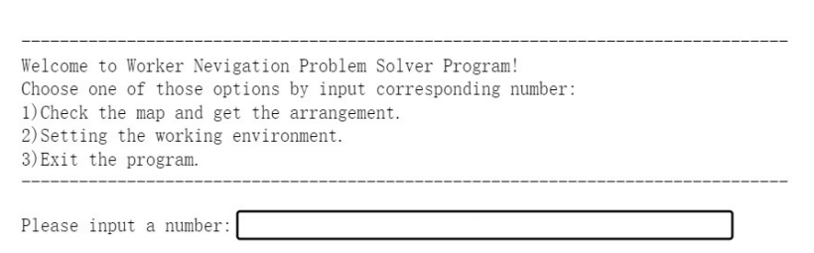
Overview of Program
Our product can:
Automatically read the warehouse environment information.
Generate visual pictures.
Supports users to query product location.
Generates instructions for workers' pick-up routes.
Fig.2.1 Screenshot of the beginning of the WMS.

Slide 3
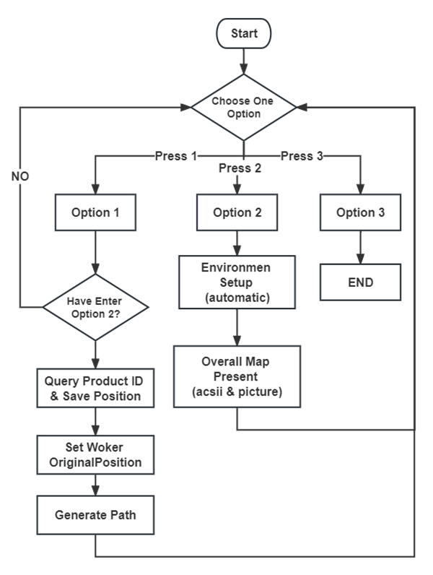
Overview of Program
How to use our products ?
Step 1 (Press option 2):
Set environment.
Step 2 (Press option 1):
Check product position.
Set worker position.
Find the route.
Return option 2 or 1.
Step 3 (Press option 3):
End and leave.
Fig.3.1 Flowchart of the program.

Slide 4
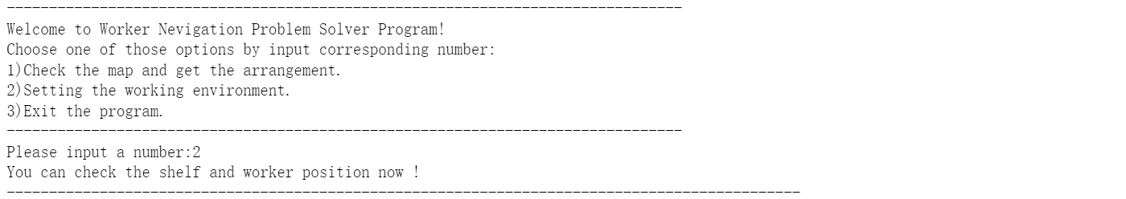
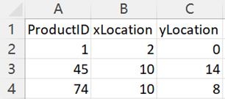
Overview of Features
Feature 1:
Set up the working environment automatically.
Fig.4.1 Data is automatically read from excel.
Fig.4.2 Excel data format.

Slide 5
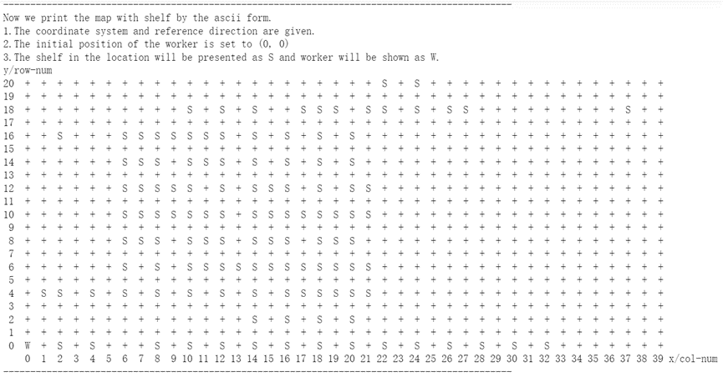
Overview of Features
Feature 2:
Display map with shelf position (part 1).
Fig.5.1 Overall map in ascii form.

Slide 6
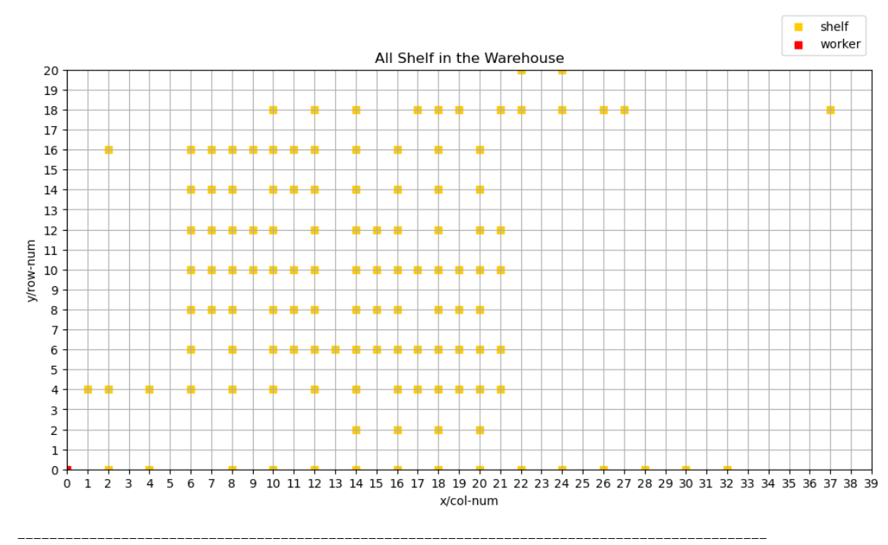
Overview of Features
Feature 2 (Advanced):
Display map with shelf position (part 2) more vividly intuitive.
Fig.6.1 Overall map.

Slide 7
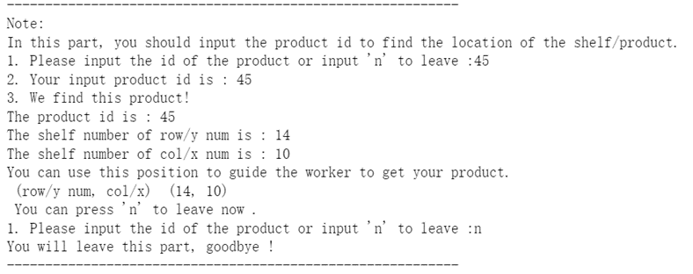
Overview of Features
Feature 3:
You can check product location and worker can fetch it later.
Incorrect entries will be prompted and retyped.
Users can retype.
Fig.7.1 Product id query and location saving.

Slide 8
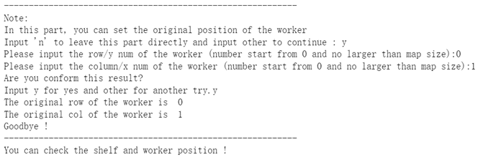
Overview of Features
Feature 4 (Advanced):
You can set the initial location of the worker.
Incorrect entries will be prompted and retyped.
Users can retype.
Fig.8.1 Set the initial location of worker.

Slide 9
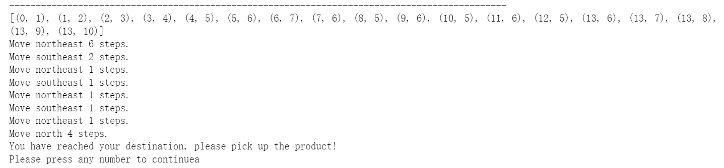
Overview of Features
Feature 5:
The program will give your worker text instructions to take the product.
Fig.9.1 Worker path indication and text instructions

Slide 10
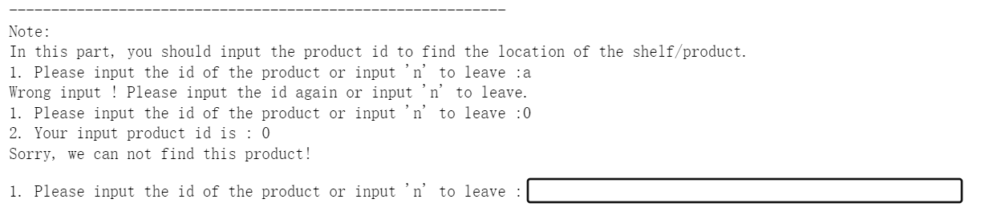
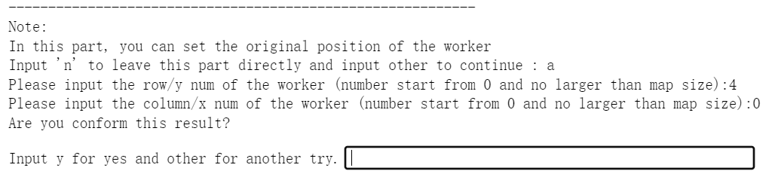
Overview of Features
Feature 6 (Advanced):
This product has a user-friendly input system.
Fig.10.1 When user input error, this program supports repeated input.
Fig.10.2 When user is not satisfied, this program supports repeated input.

Slide 11
Questions
Thank you for listening !

Slide 12

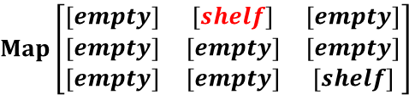

Q&A
By Xingyu Wu:
Major contributions to the documentation:
1. Write most part of user manual.
Major contributions to the code:
1. The architecture of the data structure (class Map/ Shelf/ Product).
2. Main function architecture.
3. Product location query.
4. Worker initial position setting.
Interesting part of code:
1. Objects are classes. (Easy to maintain and manage.)
2. The map is a matrix and entries are lists (of the shelf). (Clear and easy to understand)
3. User input is fault tolerant. (user-friendly)
P$roduct\left[row,col,id\right]$
S$helf\left[product,product,product,product\right]$
$$Map\left[\begin{matrix}[empty] & [shelf] & [empty] \\ [empty] & [empty] & [empty] \\ [empty] & [empty] & [shelf]\end{matrix}\right]$$
Fig.12.1 Data structure.

